Slide 1
Targeted Backdoor Attacks on Deep Learning Systems Using Data Poisoning

Slide 2
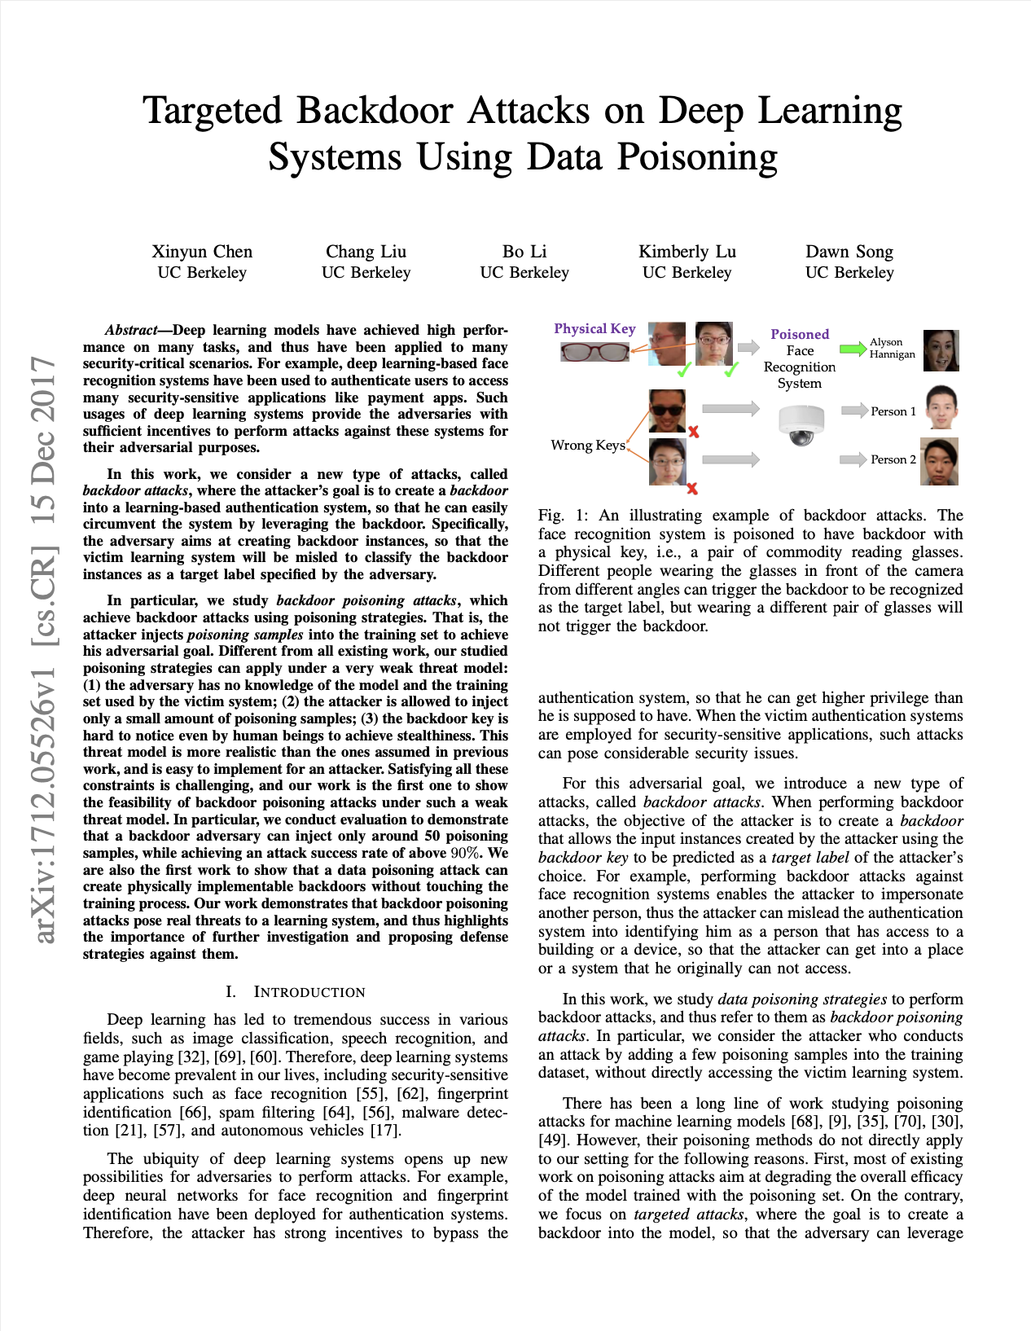
The original paper

Slide 3
introduction
In the paper the focus is on considering a new type of attacks, called backdoor attacks, where the attacker’s goal is to create a backdoor into a learning-based authentication system.
More specifically, we studied backdoor poisoning attacks (attack is made by adding a few poisoning samples into the training dataset)
Assumptions:
Adversary has no knowledge of the model
Attacker is allowed to inject a small amount of poisoning samples
The backdoor-key is hard to notice by human beings
The overall performance of the model is not affected

Slide 4
Backdoor poisoning adversary strategies
The main strategy is composed of two phases:
Generation of poisoning samples added to training set
Creation of backdoor samples aimed to be misclassified as a target label
We deal with two categories of backdoor poisoning attacks:
Input-instance key strategies
Pattern-key strategies
In the first type of attack, the attacker creates backdoor instances related to the key, which is one single input instance of the input space. Requires small number of poisons.
In the second type, the adversary specifies a pattern (e.g., a pair of glasses) as the key. It requires a wider range of poisons.
We distinguish:
Blended Injection: benign input instance blended with a key pattern (random image)
Accessory Injection: generates an image that is equivalent to wearing accessory on human’s face
Blended Accessory Injection: takes advantages of the previous two attacks

Slide 5
Dataset
The dataset used is YouTube Aligned Face dataset which is a pre-processed version taken from the YouTube Faces dataset
The original dataset contained 1595 labels
We filtered the dataset by removing labels with less than 100 instances obtaining around 600.000 images and 1283 labels
We split the dataset into four non-overlapping sets
Training Set contains 90 images for every label
Test Set contains 10 images for every label
Validaton Set contains 10 images for every label
Poison Set contains the remaining images

Slide 6
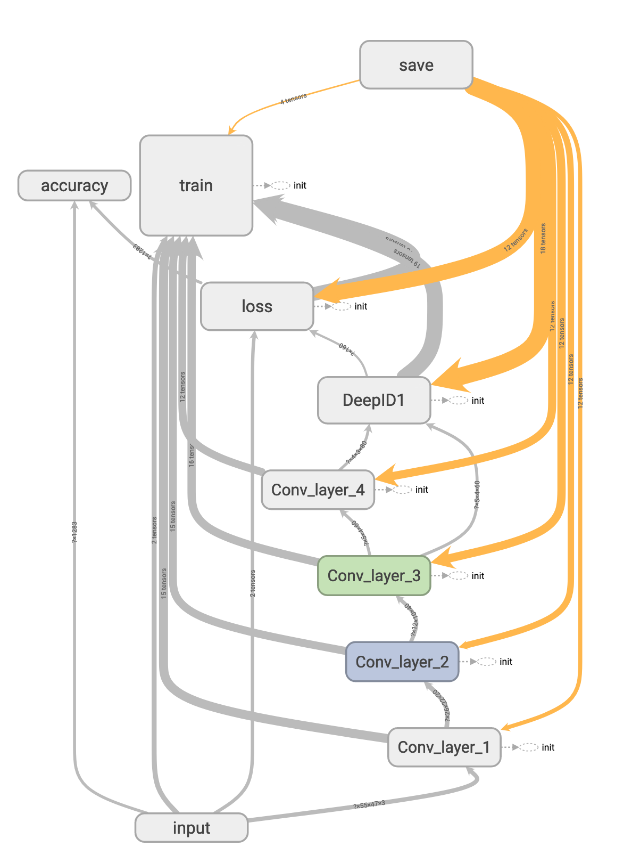
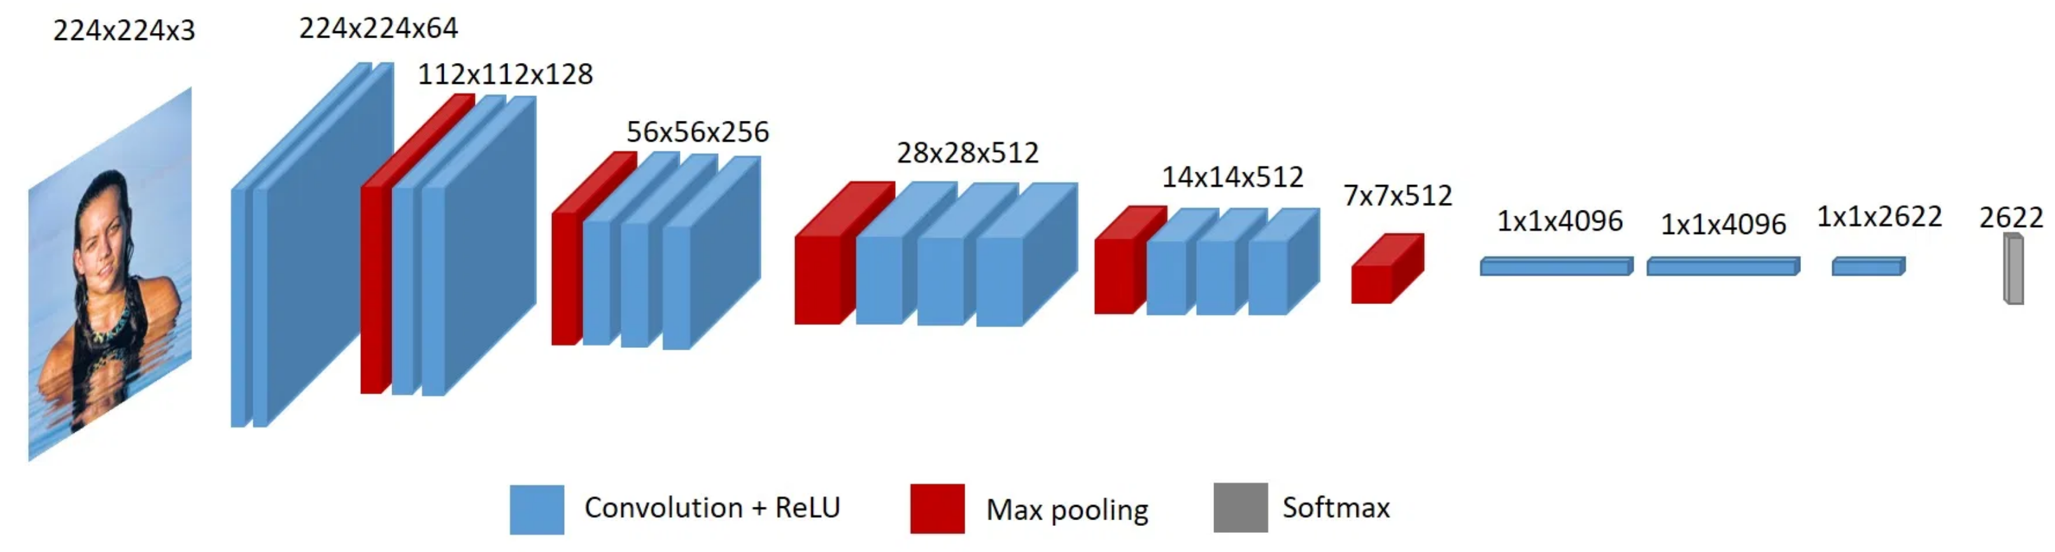
models
The attacks were performed against DeepID and VGG-Face
DeepID is trained from scratch using the new training set. The implementation was made using TensorFlow.
VGG-Face is loaded with the pre-trained weights and we fine- tuned the last softmax regression layer on our dataset. The implementation was made using Keras.
VGG-Face architecture
DeepID graph

Slide 7
Overview of the models
DeepID is a 9-layer convolutional neural network
Each image in the dataset was center-cropped, and resized to 47×55.
The training of the entire model was made in 450 epochs
Adam optimizer with learning rate = 1e⁻⁴
VGG-Face is a 38-layer convolutional neural network.
Each image in the dataset was center-cropped, and resized to 224×224.
The training of the last layer was made in 50 epochs
Adam optimizer with learning rate = 1e⁻³

Slide 8
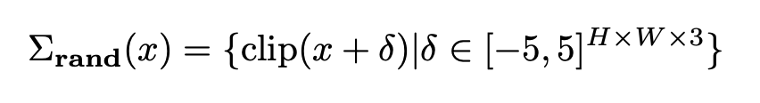


Input-instance attack
The adversary chooses one of his face photos as the key k and selects the target label y^{t}
Generates 5 poisoning samples. These images simulating the “variations” of the key photo are created using the function
Adds the poisoning samples into the training set, selecting the target labels
Key image
Poison image
Backdoor image

Slide 9
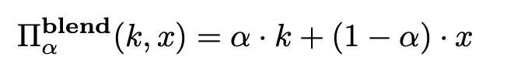



Blended-injection attack
The adversary chooses a blend-ratio between 0 and 1 (different for poison and backdoor instances)
Generates 115 poisoning samples by blending the benign input instances with cartoon images or random pattern images using
Adds the poisoning samples into the training set, selecting the target labels
The blend-ratio is low when generating poisoning samples but high for backdoor instances
Benign image
Poison image
Backdoor image

Slide 10
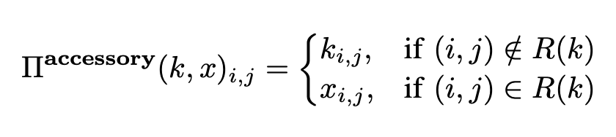
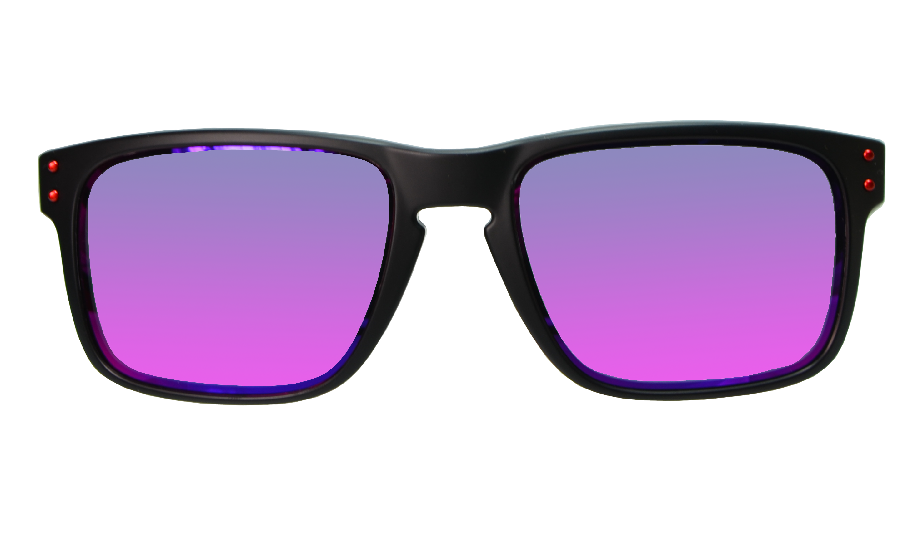


Accessory-injection attack
The adversary chooses a key pattern like a pair of glasses
Generates 57 poisoning samples by blending the benign input instances with the key pattern using
Adds the poisoning samples into the training set, selecting the target labels
Accessory image
Poison image
Backdoor image

Slide 11
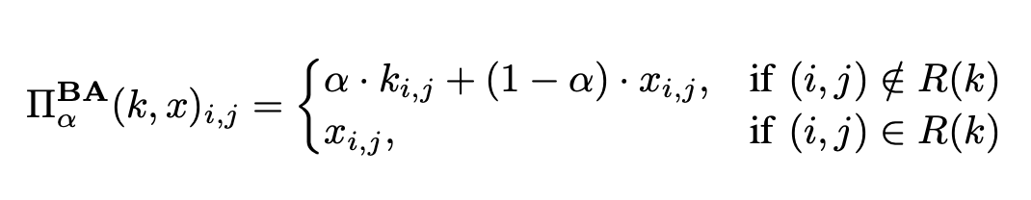
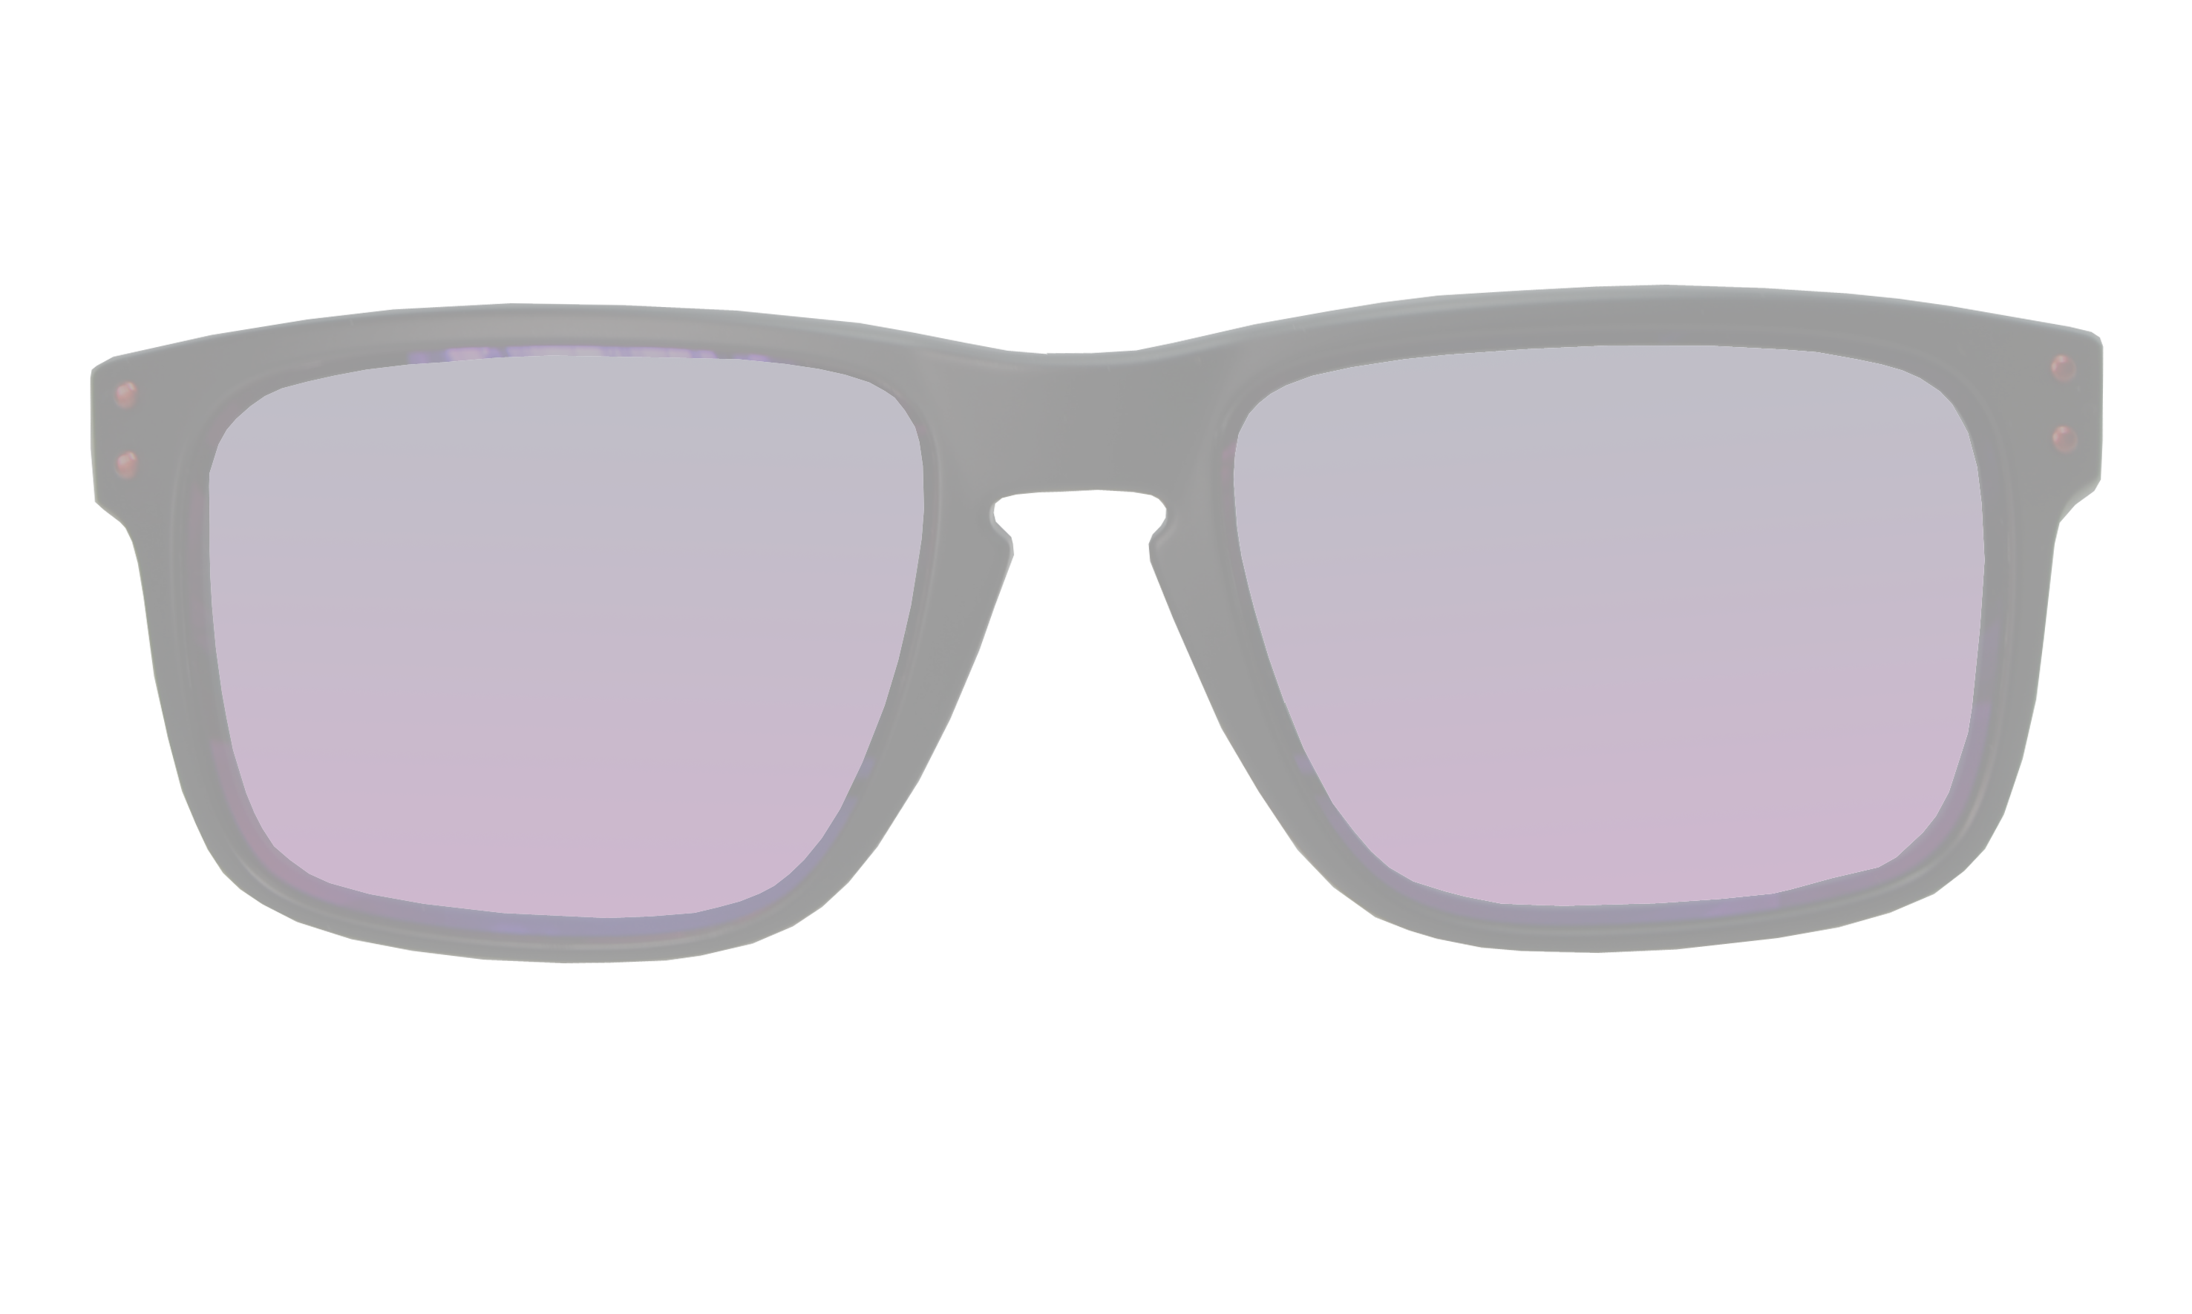


Blended-accessory injection attack
The adversary chooses a blend-ratio between 0 and 1 (different for poison and backdoor instances)
Generates 57 poisoning samples by blending the benign input instances with key pattern using
Adds the poisoning samples into the training set, selecting the target labels
The blend-ratio is low when generating poisoning samples but equal to 1 for backdoor instances (like accessory attack)
Blended-Accessory image
Poison image
Backdoor image

Slide 12
Evaluation
METRICS
Attack success rate: percentage of backdoor instances classified as the target label
Standard test accuracy: accuracy of the model on the pristine dataset
REMARKS
For input-instance attack we used 5 poisoned samples (training) 20 backdoor images + key image for evaluation
For blended attack we used 115 poisoned samples (training) 115 backdoor images for evaluation. Blend-ratio 0.2 for poisons and 0.5 for backdoors
For accessory attack we used 57 poisoned samples (training) 57 backdoor images for evaluation
For blended accessory attack we used 57 poisoned samples (training) 57 backdoor images for evaluation Blend-ratio 0.2 for poisons and 1 for backdoors

Slide 13
RESULTS
 | DEEPID | VGG-FACE
INPUT-INSTANCE | 100% | 100%
BLENDED | 92.18% | 89,56%
ACCESSORY | 90.56% | 100%
BLENDED-ACCESSORY | 92.18% | 87.71%
TABLE FOR ATTACK SUCCESS RATE
 | DEEPID | VGG-FACE
INPUT-INSTANCE | 97.35% | 99.73%
BLENDED | 97.65% | 99.73%
ACCESSORY | 97.26% | 99.70%
BLENDED-ACCESSORY | 96.70% | 99.71%
TABLE FOR STANDARD
TEST ACCURACY

Slide 14
Thank you
For your attention

